Slide 1
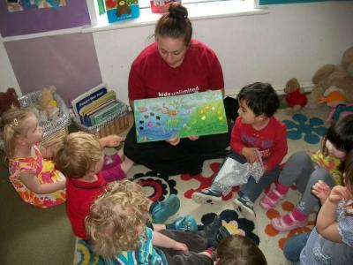
Teddy Talk
Notes:
Evolved from the SLT programme CHAT, targeting language development difficulties. Works for EAL, but development not needed, just transfer of words.

Slide 2
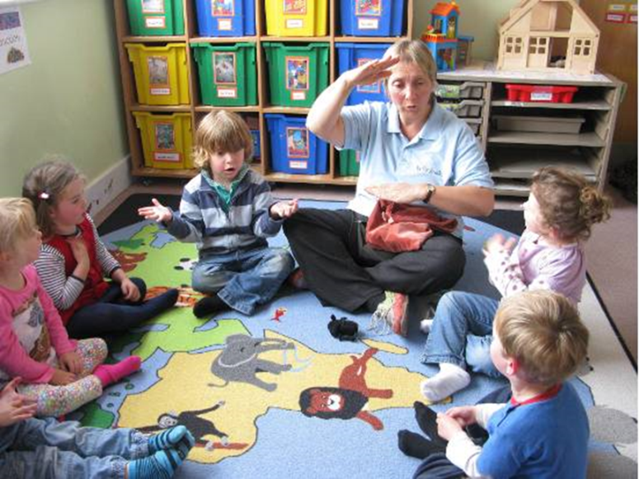
Why does it work?
What strategies/techniques did I use to support the children’s language?
In what other situations might you use these strategies with EAL learners?
Can you think of any other ASN needs that might be met with these strategies?

Slide 3
Why it works?
At their own language level
language skills
repetition
confidence
success
pre-teaching vocab

Slide 4
Try to avoid correcting and pointing out errors
2.
1.
4.
3.
5.
Instead model and extend e.g. by asking questions

Slide 5
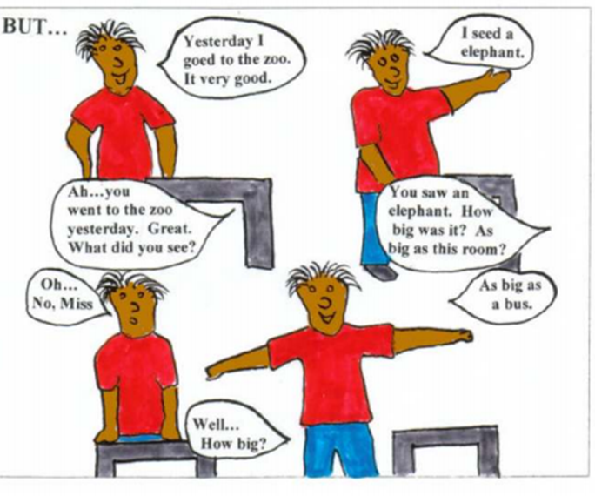
1.
2.
3.

Slide 6
How could you MODEL and EXTEND
these examples…
“I eated a pizza.”
“I saw cat.”
“Him!”
“You help.”
“No understand.”
“It a police bus.”

Slide 7
Lets Practice!

Slide 8
Teddy Talk Sessions
15/20 mins
2/3 times a week
Pack repeated 2/3 times
No more than 5/6 pupils in a group
Use Teddy Talk record sheet

Slide 9
http://ealhighland.org.uk/resources/big-bear-banter/

Slide 10
EAL Highland
http://ealhighland.org.uk/

Slide 11
Content of a Teddy Talk Pack
Front cover (black and white)-laminated
2 sets of flashcards (colour)-laminated and cut out
1 book- as recommended, or any that reinforces the vocabulary
Props (optional but recommended)

Slide 12
Content of a Teddy Talk Bag:
A Teddy
A piece of material
Good sitting, good looking and good listening signs
Teddy Talk record sheet and pencil

