Slide 1
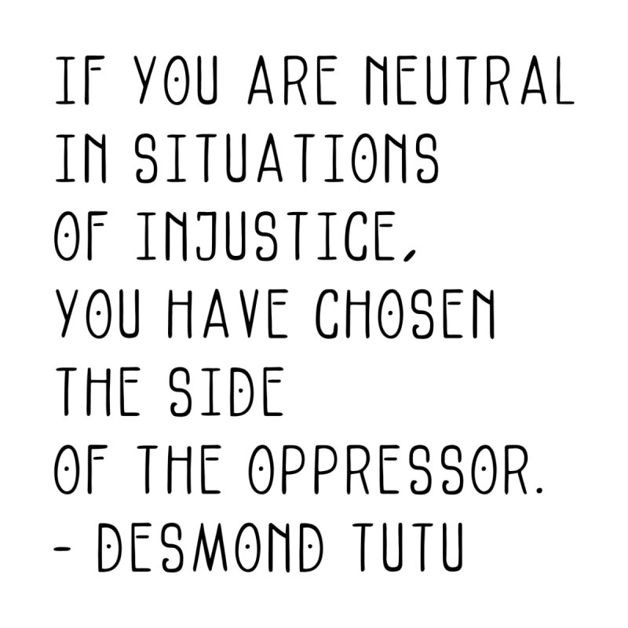

Slide 4
For our own education:
Eg. Why US protests resonate in the UK (Newsbeat)
The racism that killed George Floyd was built in Britain (Afua Hirsch)
Scaffolded antiracist resources. Brilliant google doc with suggested videos, podcasts, articles, books, blogs for different stages of white identity development. Also includes a questionnaire for anti-racist educators, and resources for young people.
Diversity in Diction: Guidance on language (STUC) – in shared drive
BAME Ed Network – advice on being an ally (and books for children) in shared drive
https://theteacherist.com/ Blog by Pran Patel
A letter from a Headteacher (from blog above) is worth a read

Slide 5
Anti-Racism teaching resources
https://www.chooserespect.scot/ (anti bullying campaign)
4 steps: Self reflection, Celebrating difference, Building Empathy, Positive relationships.
Exploring stereotypes and anti-racism resource
Show Racism the Red Card https://www.theredcard.org/resources-and-activities
Anti-Racism Education Pack saved on Shared drive
Black Lives Matter at School 2020 Curriculum Resource Pack – google drive from ELC to senior phase
Also work on Rights. Check out resources on http://www.signpostsglobalcitizenship.org and the RISC toolkit for measuring attitudes http://toolkit.risc.org.uk/
Refugee Week 2020 is 15-21 June: ‘Imagine’
https://refugeeweek.org.uk/simple-acts/ 8 simple acts to build a better world…
Refugee Week 2020 Children & Young People’s Pack
#ThisismyHome Real life stories of migrants – 5 min film from Show Racism Red Card Scotland

